Slide 1
Week July 6
Quantum Troopers

Slide 2
Quantum computing textbook
The outline of the textbook is derived from lecture notes of graduate level course Quantum Computing with Noisy Qubits.
This textbook aims at introducing Quantum beginners to the functions and properties of Quantum Computers. The early chapters establish the building blocks of a quantum system, the mathematical models based on quantum mechanics. Important math tools such as linear algebra, complex functions are introduced. As we move forward, we discuss the special properties of a quantum system in depth, including superposition, entanglement, as well as their applications. Our goal here is to try and explain the physical realizations of qubits, to give a sense of why quantum computing network is built on q-bits and quantum gates.

Slide 3
What we have achieved so far
Added section on 1.1 Dirac’s notation;
Expanded on 1.3 Single qubit measurements with introduction to state vectors and probability measurement;
Added section 1.4 Mapping from C2 to R3 to explain Bloch sphere and mathematical properties of pauli matrix space, including probability invariance of global phase, unitary transformations, etc.
Went over chapter 1.4 and took down comments about the obscurities;
Understood Hamiltonian decomposition, Larmor precession, LRC oscillators, and so much more from weekly meeting sessions with Professor Shabani;

Slide 4
Next Week Plans
Add the 0th chapter on linear algebra - Yuelong Li
Learn the basics of Lagrangian and Hamiltonian to better understand principles involved in two state quantum mechanical system
Go through chapter 5 and take down notes
Complete first chapter on dirac notations, complex functions, and measurement of wave functions -Daniel Li
Learn physics behind gyromagnetic ratio
Explore Josephson Junctions and expand on details as necessary
Create smaller exercises to accompany the first six chapters - Aurelia Brook
First pass through the entirety of the lecture notes to mark which changes must be made has been completed, so the focus now is to fully write out information and fine-tune
The chapter’s topics go from single qubit properties to multiple qubits, covering entanglement and quantum gates

Slide 5
Quantum computing textbook ---
Long term goals
The later chapters shed light on the relationship between QC and CC. The critical concept that determines the level of problems that quantum computers are able to resolve is computational complexity. We present examples, exercises, and diagrams to facilitate understanding on different quantum algorithms. As we demonstrate implementations on IBM Q network, we illustrate the current challenges researchers face, among them are noise generations, polarization error and other important topics related to quantum information.

Slide 6
Hackathon paper continuation
Quantify Error;
Identify the source of Error and carefully categorize them;
Understand the propagation of Error through the simulation;
Research for correlation between error sources and their impact upon the result through control variable method;
Optimize the results

Slide 7
The Elitzur-Vaidman Bomb
Andreas Tsantilas

Slide 8
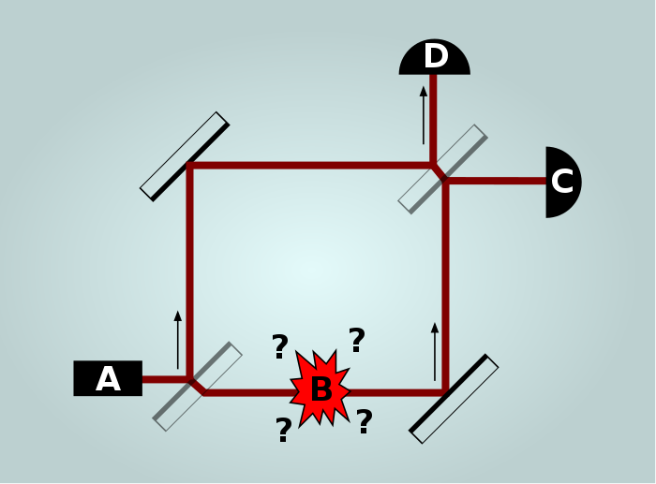
Background
Avshalom Elitzur and Lev Vaidman They proposed a thought experiment in which one could verify a bomb is functional without having to detonate it.
Demonstrates is that of interaction-free measurement.
These have been experimentally verified.
E&V’s setup involved photon-sensitive bombs, and looked something like this:
Can detect a bomb is functional, 50% success rate!
Can we make the error arbitrarily small?

Slide 9

Trouble at the Airport!
Suppose you are at an airport, and there is a suspicious piece of luggage left lying around. This suitcase may or may not contain a bomb; of course, if you open the suitcase, the bomb explodes.

Slide 10

Classical Setup
The suitcase does, however, have an interface. It can be sent a classical bit, where b = 0 means we don't make a query, and b = 1 means we do.
This is a predicament; if we send 0, we don't learn anything, and if we send 1, we risk the bomb blowing up in our face!
How can you determine if there is a bomb in the suitcase?

Slide 11
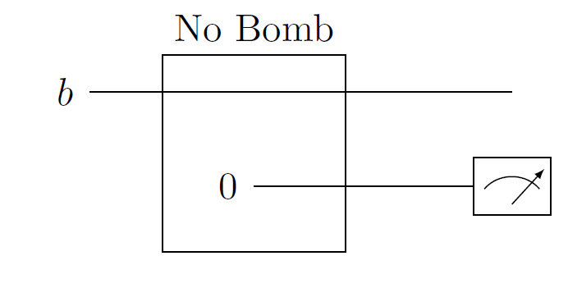
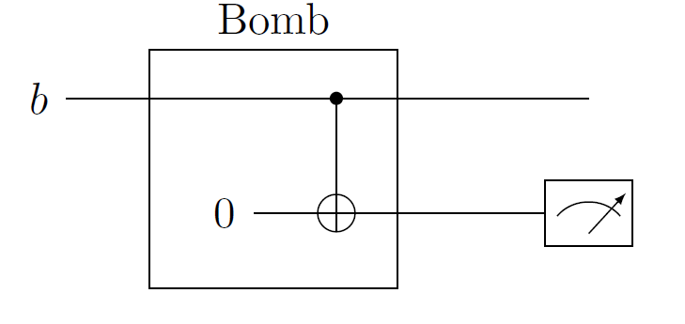
Classical Circuits
The way we denote an “explosion" is if we measure the second bit in the state 1.

Slide 12
Not very Helpful...
If there is no bomb, and we send in b = 0, then we measure 0.
If there is a bomb, and we send in b = 0, then we also measure 0.
So sending in b = 0 doesn't give us any information about what's going on inside.
If there is no bomb, and we send in b = 1, then we measure zero. We can say for certain, then, that there isn't a bomb.
If there is a bomb, and b = 1, then the suitcase explodes.

Slide 13

Quantum Setup
Let's suppose the query system is a quantum one. That is, we are allowed to send in a quantum bit to the suitcase:
Let's assume that if there is no bomb, then |ψ> is returned.
If there is a bomb, the bomb measures the second qubit in the basis {|0>, |1>}. If the outcome is |0>, then because the states of the two qubits are entangled, our qubit |ψ> immediately collapses to |0> and therefore returns |0>.
If the output is |1>, the bomb explodes (and then returns 1).

Slide 14
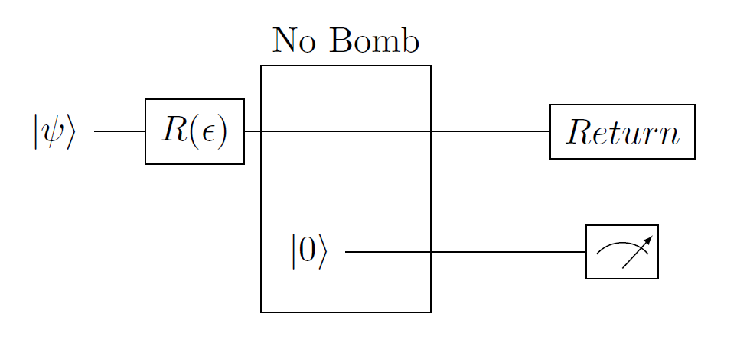
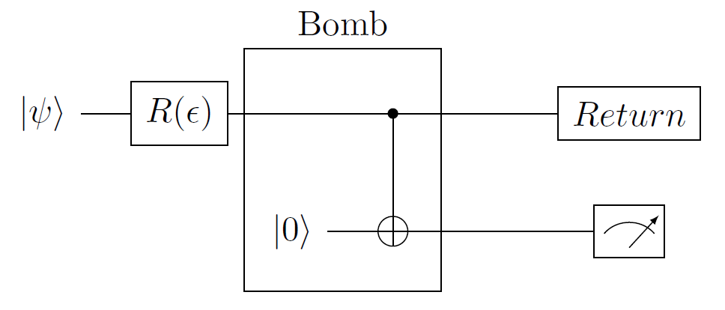
Quantum Circuits

Slide 15

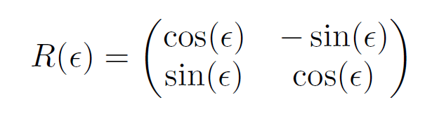

The Process
How do we go about testing if there is a bomb? The idea is to start in the state |ψ> = |0>. Next, we apply an arbitrarily small rotation of angle
Where N is the number of queries we would like to send, which can be arbitrarily large.
If there is a bomb, the chance that it explodes is which means the bomb doesn’t blow up with high probability.

Slide 16

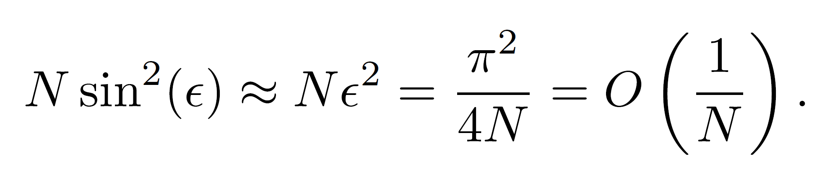
The Process (cont’d)
We feed our qubit |ψ> through the machine N times, and then measure |ψ> safely in our lab, and we will see one of two results.
If there is no bomb, our state is
If there IS a bomb, each time we feed it through the circuit, we keep collapsing our state back to |0> with a high probability. That is, we reset it each time.
Therefore, the total probability of blowing up is just

Slide 17
Conclusions
If there is no bomb, we measure |1> in our lab after doing N repetitions,
If there is, we measure |0>in our lab since the circuit keeps resetting the state of |1> to zero.
If N = 100 repetitions, then our chance of exploding (if there is a bomb) is about 2.47%.
Has implications for MWI interpretation of quantum mechanics

